Slide 1
Project 2: R&D Investment under National Uncertainty
DATA 201 - Spring 2026
Raul Miranda

Slide 2
Motivation
Future investments in R&D depend on wealth, human development, policy, competitiveness, and may be influenced by uncertainty factors.
QUESTIONS:
1. Can we quantify how wealth drives technology (GDP/capita vs. R&D expenditure)?
2. Have different regions of the world developed independent correlations?
3. How influential are human factors (health and education) on R&D expenditure?
4. Does uncertainty affect R&D expenditure?

Slide 3
Datasets
World uncertainty index (WUI)
http://worlduncertaintyindex.com/data/
(tracks uncertainty (sentiment analysis) quarterly across the globe since 1950s. 143 countries.)
World Bank - Development Indicators (WBI)
https://databank.worldbank.org/source/world-development-indicators
(6 indicators - timeperiod: 1995-2024, 52 selected countries.)
Bias: sparse information for the less developed or more restrictive countries.
Although a good crossection of WUI and WBI was identified, the 52 countries do not include any of the low-income nations.
Merged working dataset after cleaning:
1560 rows and 11 variables

Slide 4
Variables of interest
Variable Type
iso_code ISO 3-letter country code Categorical
region middle-east, latin-america, Categorical
Asia-pacific, europe, north-america
income_group lower-middle, upper-middle, high Categorical
year Quantitative
GDP_per_capita US dollars Quantitative
Life_expectancy years Quantitative
Health_spend %GDP Quantitative
Education_spend %GDP Quantitative
RD_spend %GDP Quantitative
WUI uncertainty index Quantitative

Slide 5
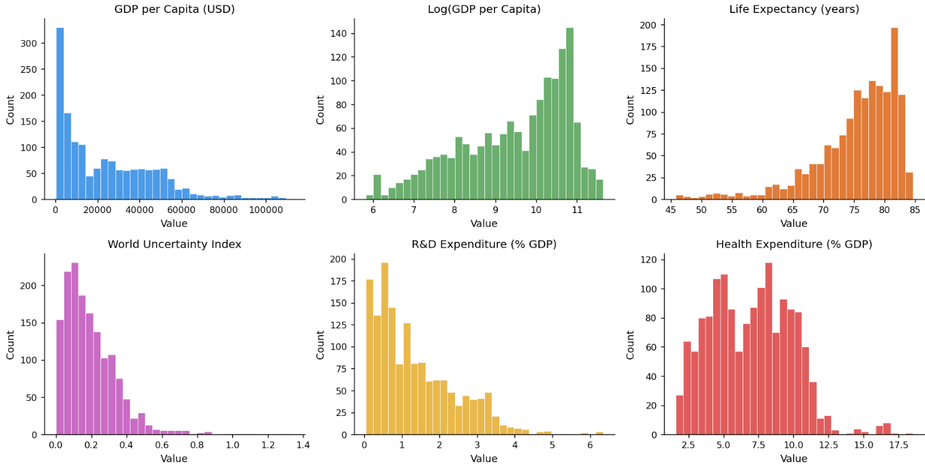
Exploratory data analysis and visualization

Slide 6
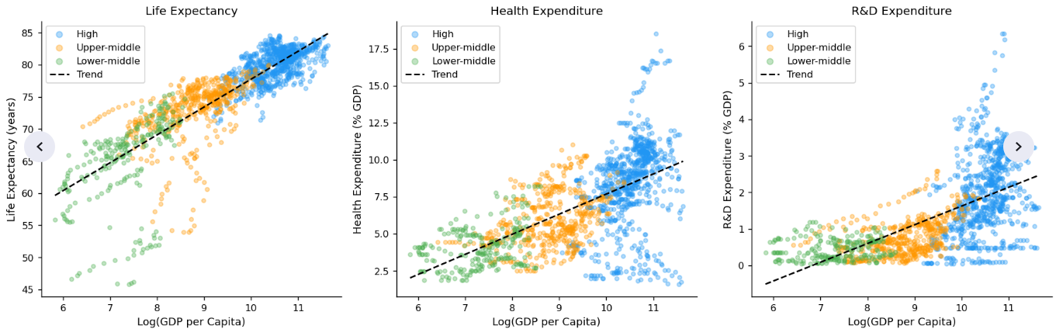
Correlations with respect to log_gdp/capita

Slide 7
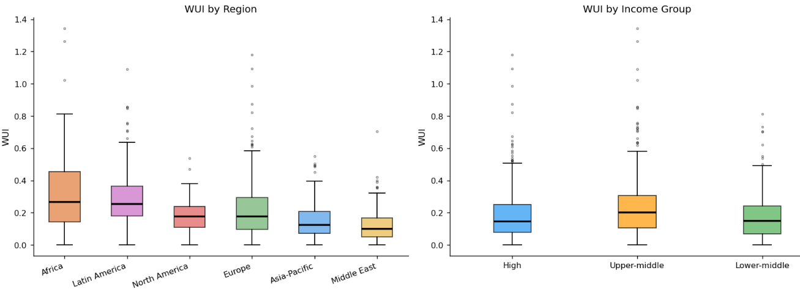
World Uncertainty Index by region and income group

Slide 8
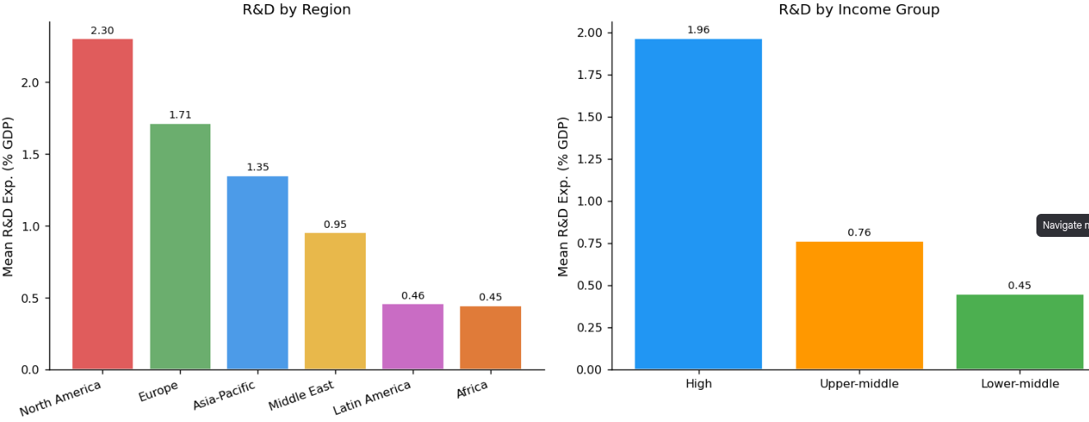
Mean R&D investment by region and income group

Slide 9
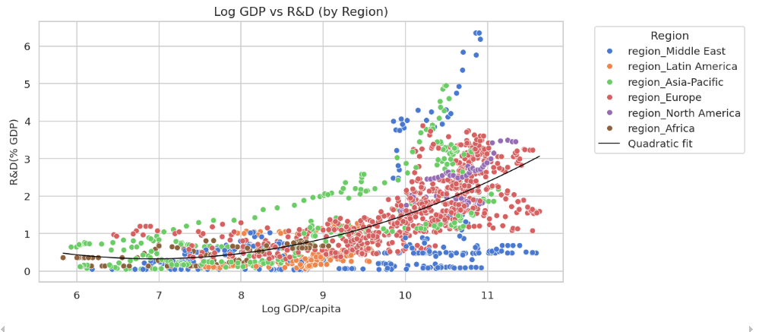
Quadratic fit to R&D vs log GDP/capita

Slide 10
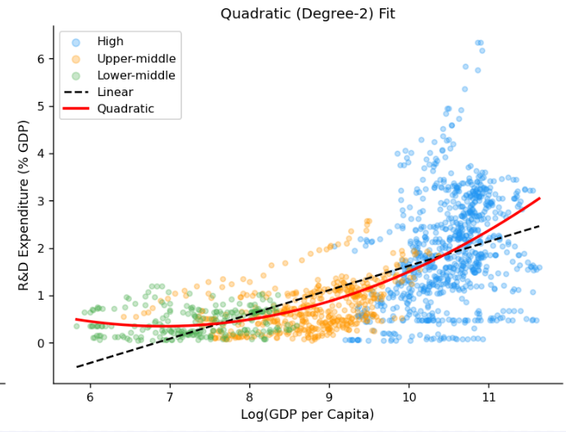

Slide 11
Models Results for prediction of R&D
Tried 4 models:
0. Linear Regression without region and income group included
Linear regression including all features, including region and income group
Polynomial regression: quadratic in log GDP
Interaction of log GDP and WUI
Model Comparison:
Model RMSE R2
0 Linear 0.780412 0.506989
1 Linear with Categorical 0.688461 0.616321
2 Polynomial 0.689879 0.614739
3 Interaction 0.688766 0.615981

Slide 12
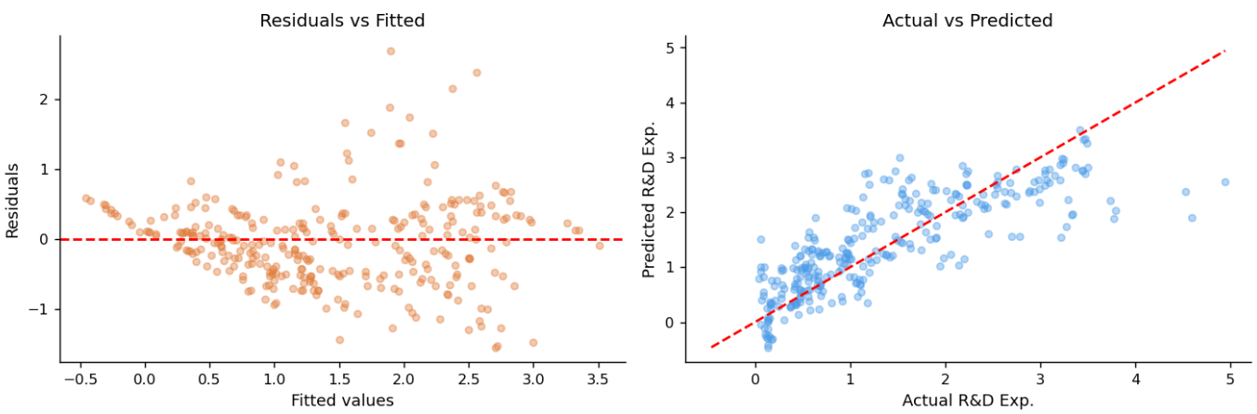
Model 2: Residuals and Actual vs Predicted R&D (% GDP)

Slide 13
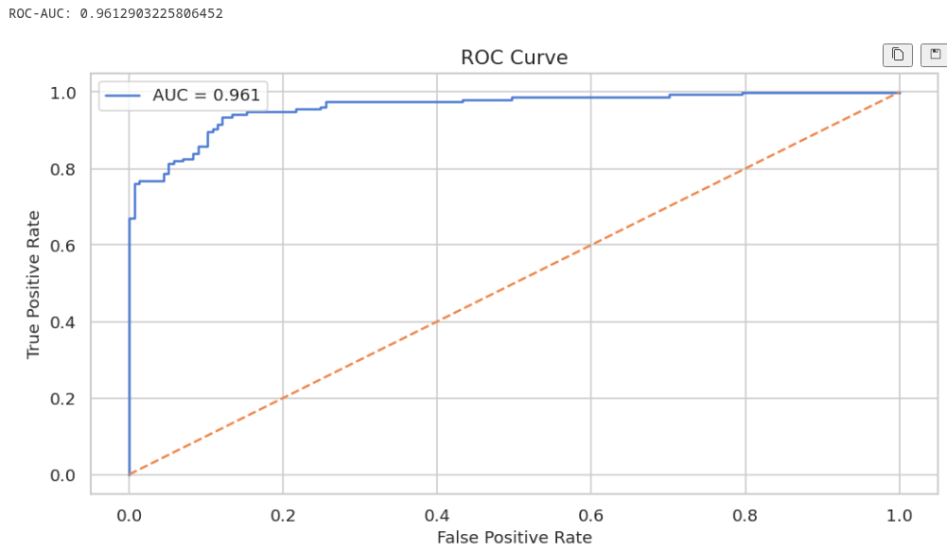
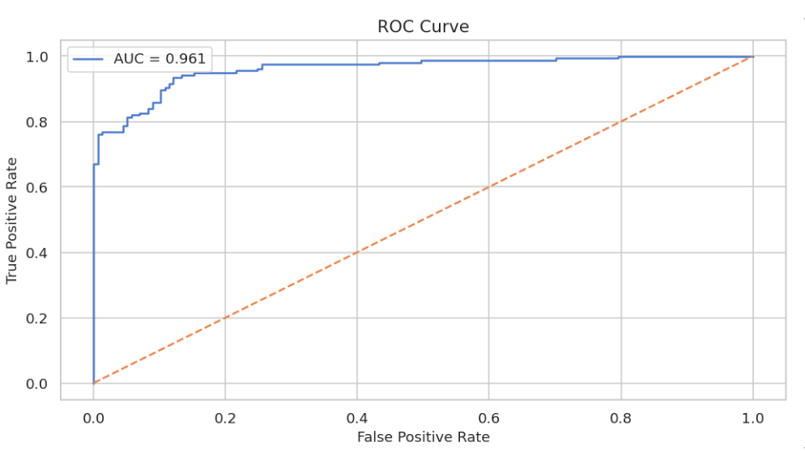
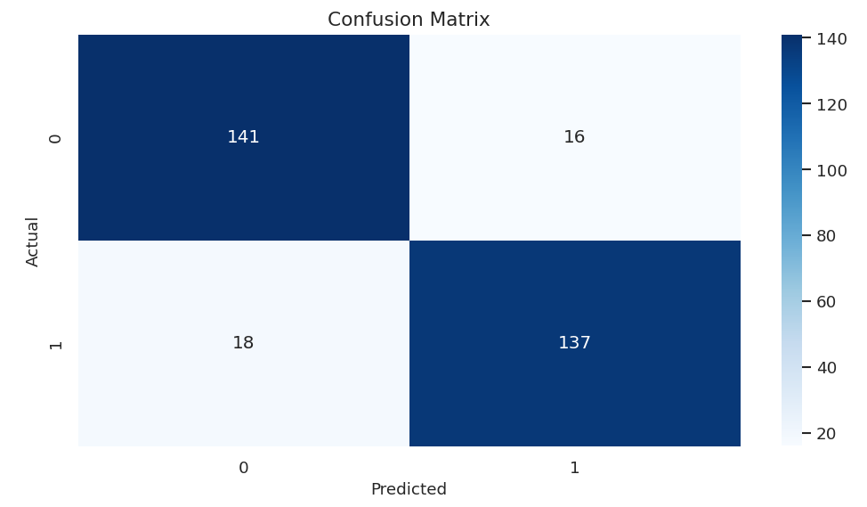
Logistic regression and classification of countries by R&D expenditure
Regression accuracy: 0.89

Slide 14
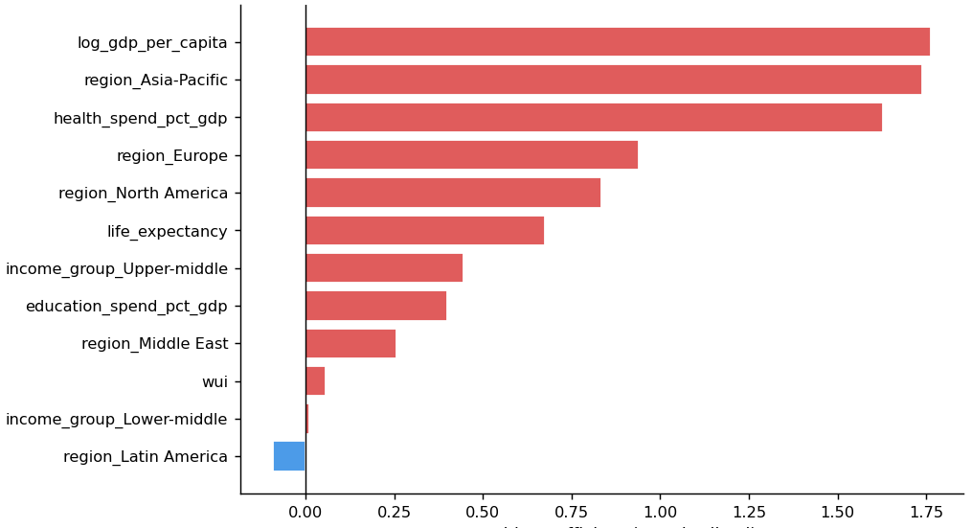
Logistic correlation coefficients vs log odds: variable importance

Slide 15
Conclusions
R&D expenditure across countries, focusing on the roles of economic development, human development, and uncertainty:
First, economic wealth is the dominant driver of R&D investment. Diminishing returns.
Second, structural factors such as region and income group play a critical role.
Third, the role of uncertainty appears to be limited.One possible explanation is that R&D expenditure reflects long-term strategic investment decisions. Structural factors are more important determinants.
These insights have implications for policy, as they emphasize the importance of sustained economic development and institutional support for innovation, over short-term responses to uncertainty. I.e., continue to fund good research even during tough times!

